Slide 3
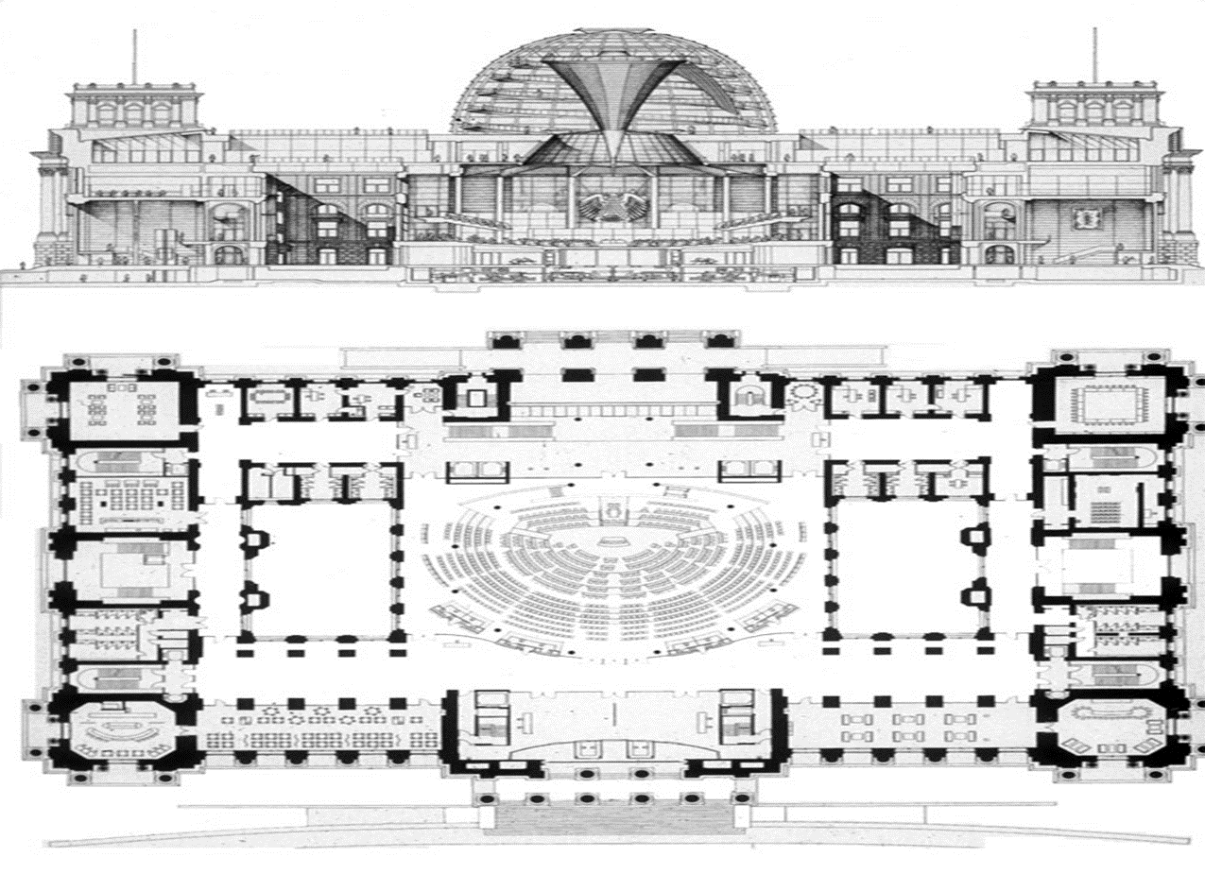
Architect’s Rendering of the new dome

Slide 4
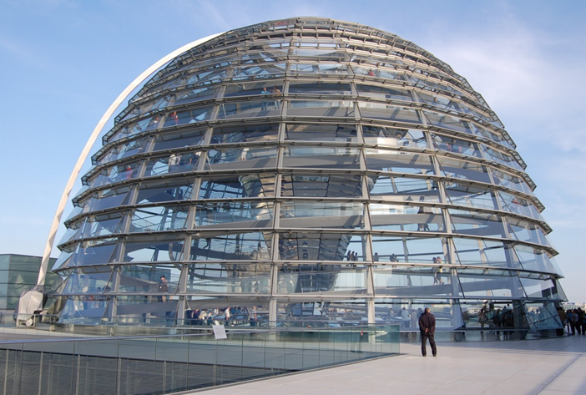
The Dome

Slide 5
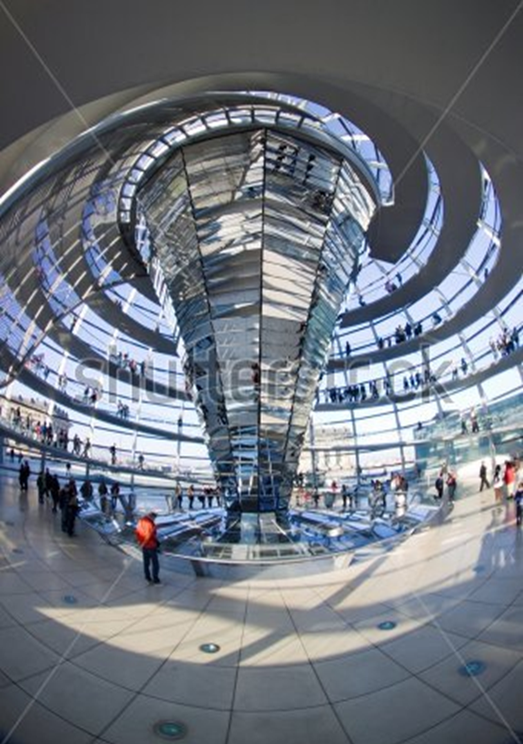
The Mirrored Funnel

