Slide 1
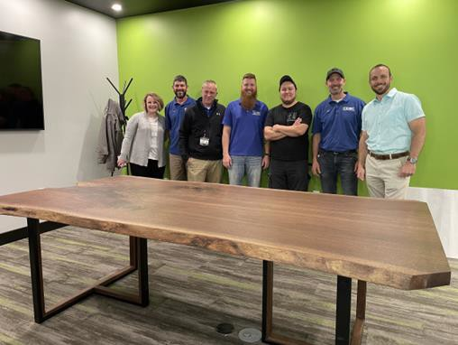
LAKE ERIE WOODWORKS, Erie, PA
WHY CUSTOM FURNITURE?…
I have been building furniture and wooden goods since 2008, a hobby that became a passion, and eventually a business. My love of woodworking was passed down from my grandfather, to his 7 sons, and from my father to me. I fondly remember the basement shop where they worked making cabinets and furniture. I didn’t intend on turning custom woodworking into a business, but after several successful projects, I decided to take the plunge!
Lake Erie Woodworks was created in 2018, and since then has grown into the go-to source for custom wood furniture, custom millwork, and retail display solutions.
Armando R. Reyes Owner| Craftsman
Lake Erie Woodworks 814.566.8072
lakeeriewoodworks.com
Lake Erie Woodworks also offers classes in woodworking for those eager to learn. Go to the website to sign up!

Slide 2
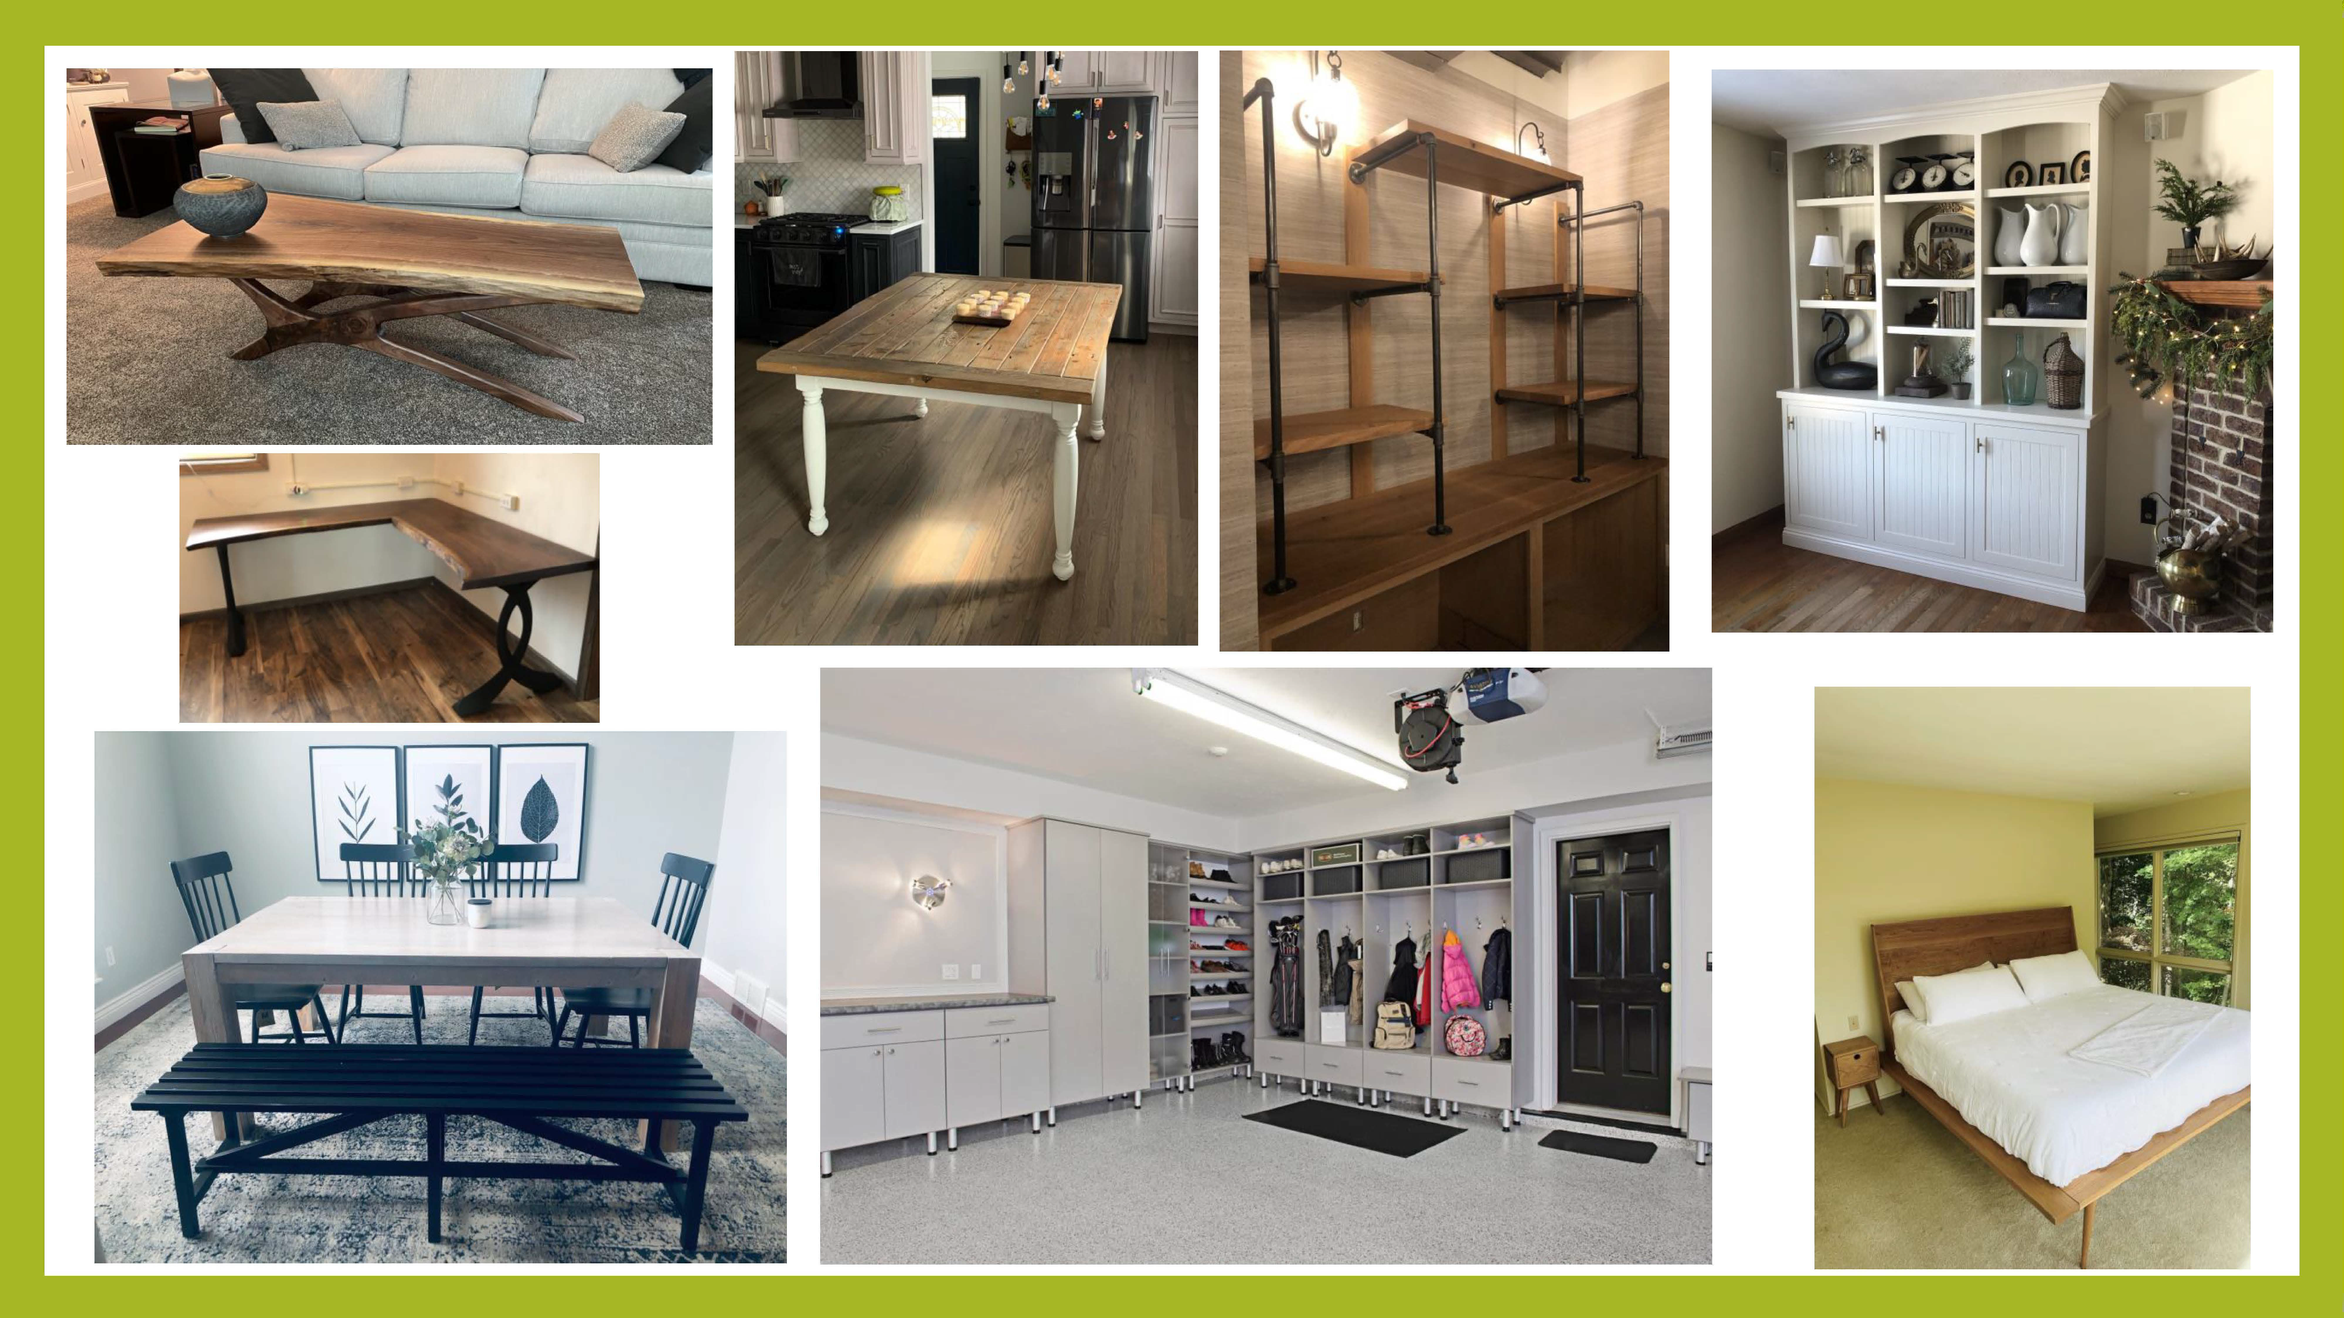
Completed
Projects

