Slide 1
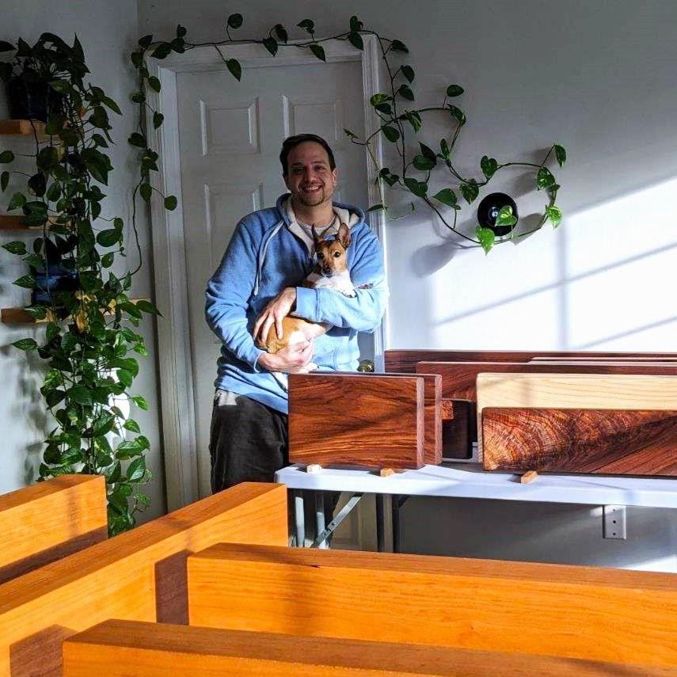
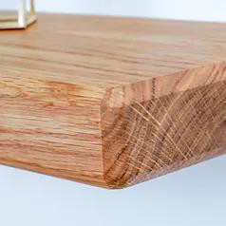
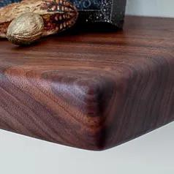
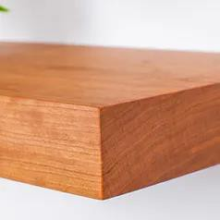
In 2019, Oakford Home Furnishings began as a small, custom furniture workshop. Today, we are proud to have found our niche helping Designers, Design-Build Firms, Kitchen/Bath Remodelers, and Individual Homeowners craft custom shelving for their residential and commercial properties.
We use domestic and exotic woods obtained responsibly from local lumber suppliers whenever possible, and partner with One Tree Planted, so that each shelf sold plants a tree in an area of the world in need.
While many of our most popular pre-configured product options are available for direct order on our site, we also encourage you to contact us directly to discuss your project needs. Shelving is rarely one size fits all!
Meet the team...
“Together with my wife, Allia, and our shop helper pup, Paya, we are proud to provide exceptional service and beautiful hardwood shelving to our clients and customers. We believe that every detail matters in all aspects of our work and strive to ensure that every piece that leaves our workshop is made with quality and care.
We only use the highest quality materials and finishing products to ensure that your shelves are beautiful and built to stand the test of time. Our goal is to let each piece of wood speak for itself and to show off it's natural beauty."
Samuel Twardowski/Owner and Craftsman www.oakfordhomefurnishings.com sam@oakfordhome.com
215-770-6300
Walnut/Rounded
White Oak/Chamfered
Cherry/Squared

Slide 2
www.oakfordhomefurnishings.com
Made to Order, Handcrafted Shelves for Home and Commercial Projects
Our hardwood floating shelves are not your standard wall shelves, and customization is our specialty! We are readily available to consult on any design elements, and answer any questions about the process or options.
With a background in fine woodworking and fine furniture making, we take a painstakingly detailed approach to the construction of our shelves. We also use a natural hand rubbed hardwax oil finish on all of our shelves. Unlike a typical polyurethane or varnish, the finish we utilize is free from chemicals and toxic off-gassing.
Each shelf comes with the hardware needed for installation, and instructions for hanging, with tips to ensure that the shelf hangs flush against the wall. We use high quality, heavy duty metal brackets that are fit precisely in to pre-drilled holes for each shelf.
Whether it's one continuous piece of wood or multiple pieces joined together for deeper shelves, we aim to ensure the beauty of the wood grain is
maximized for every piece.
Elements that are available for customization include, but are not limited to: Wood Type (ex: Maple, Walnut, Purpleheart etc.)
Wood Finish (ex: Natural/oil, Painted etc.) Edge Profile (Squared, Rounded, Chamfered) Dimensions (Length, Width, Depth)
Curious about other options? Send us a message at sam@oakfordhome.com!

