Slide 1
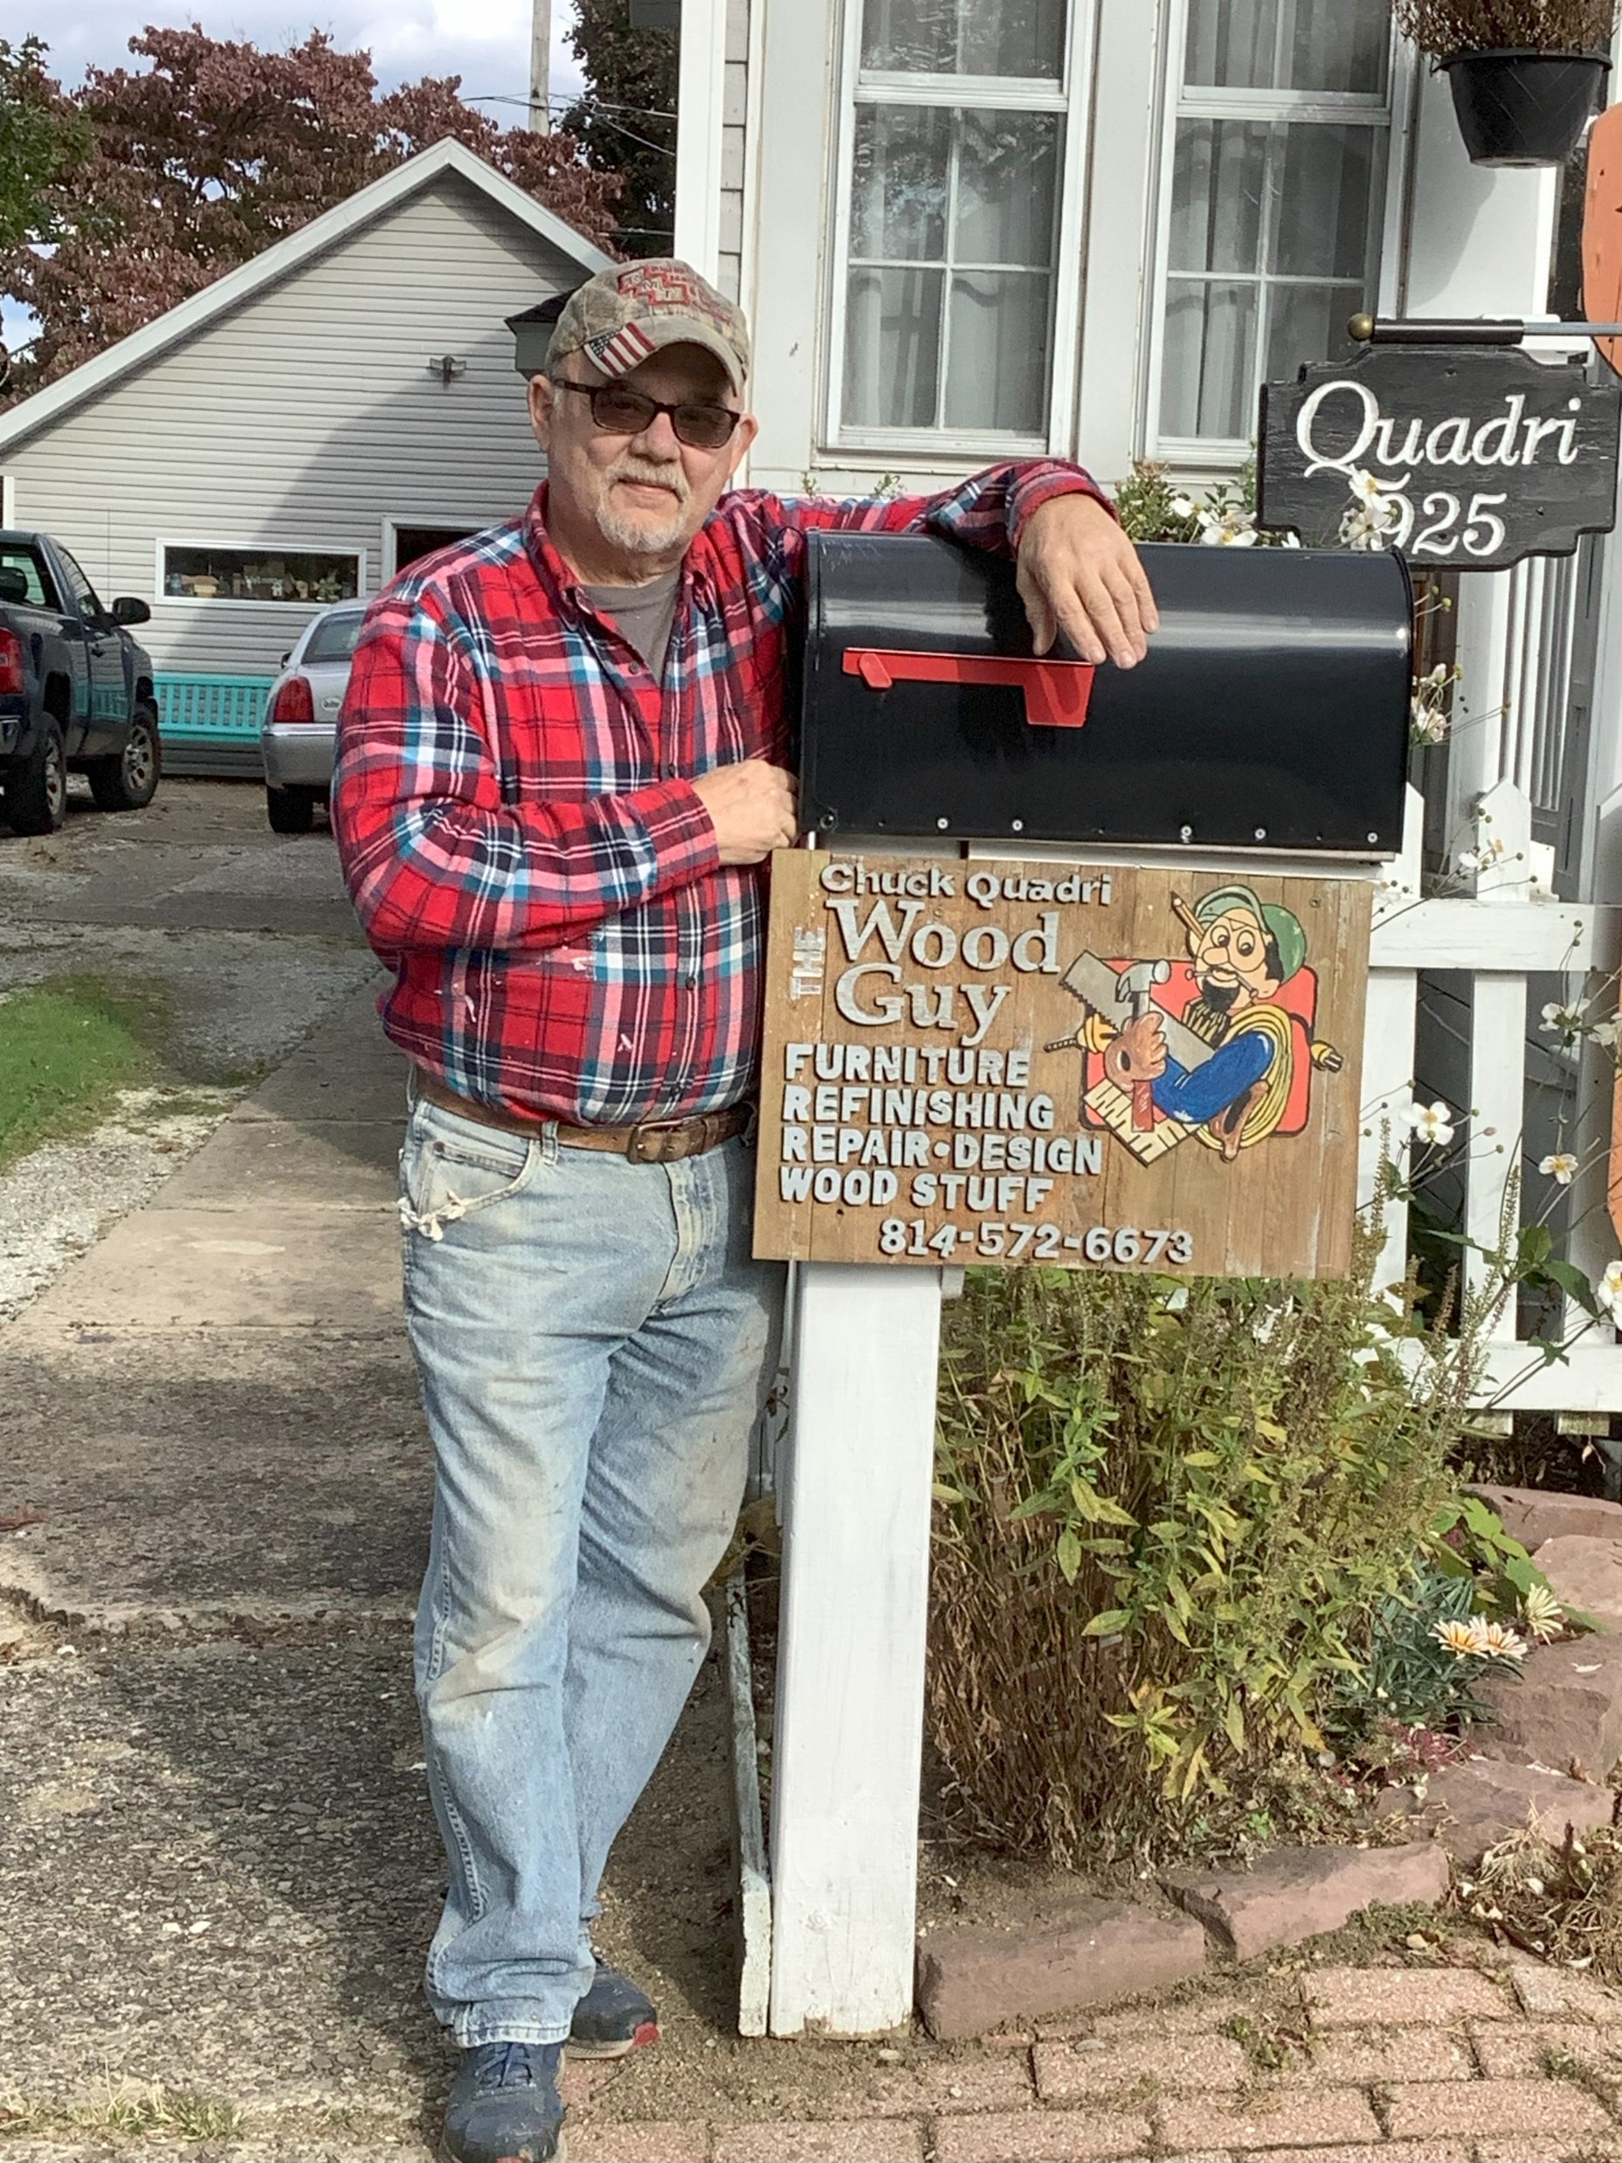
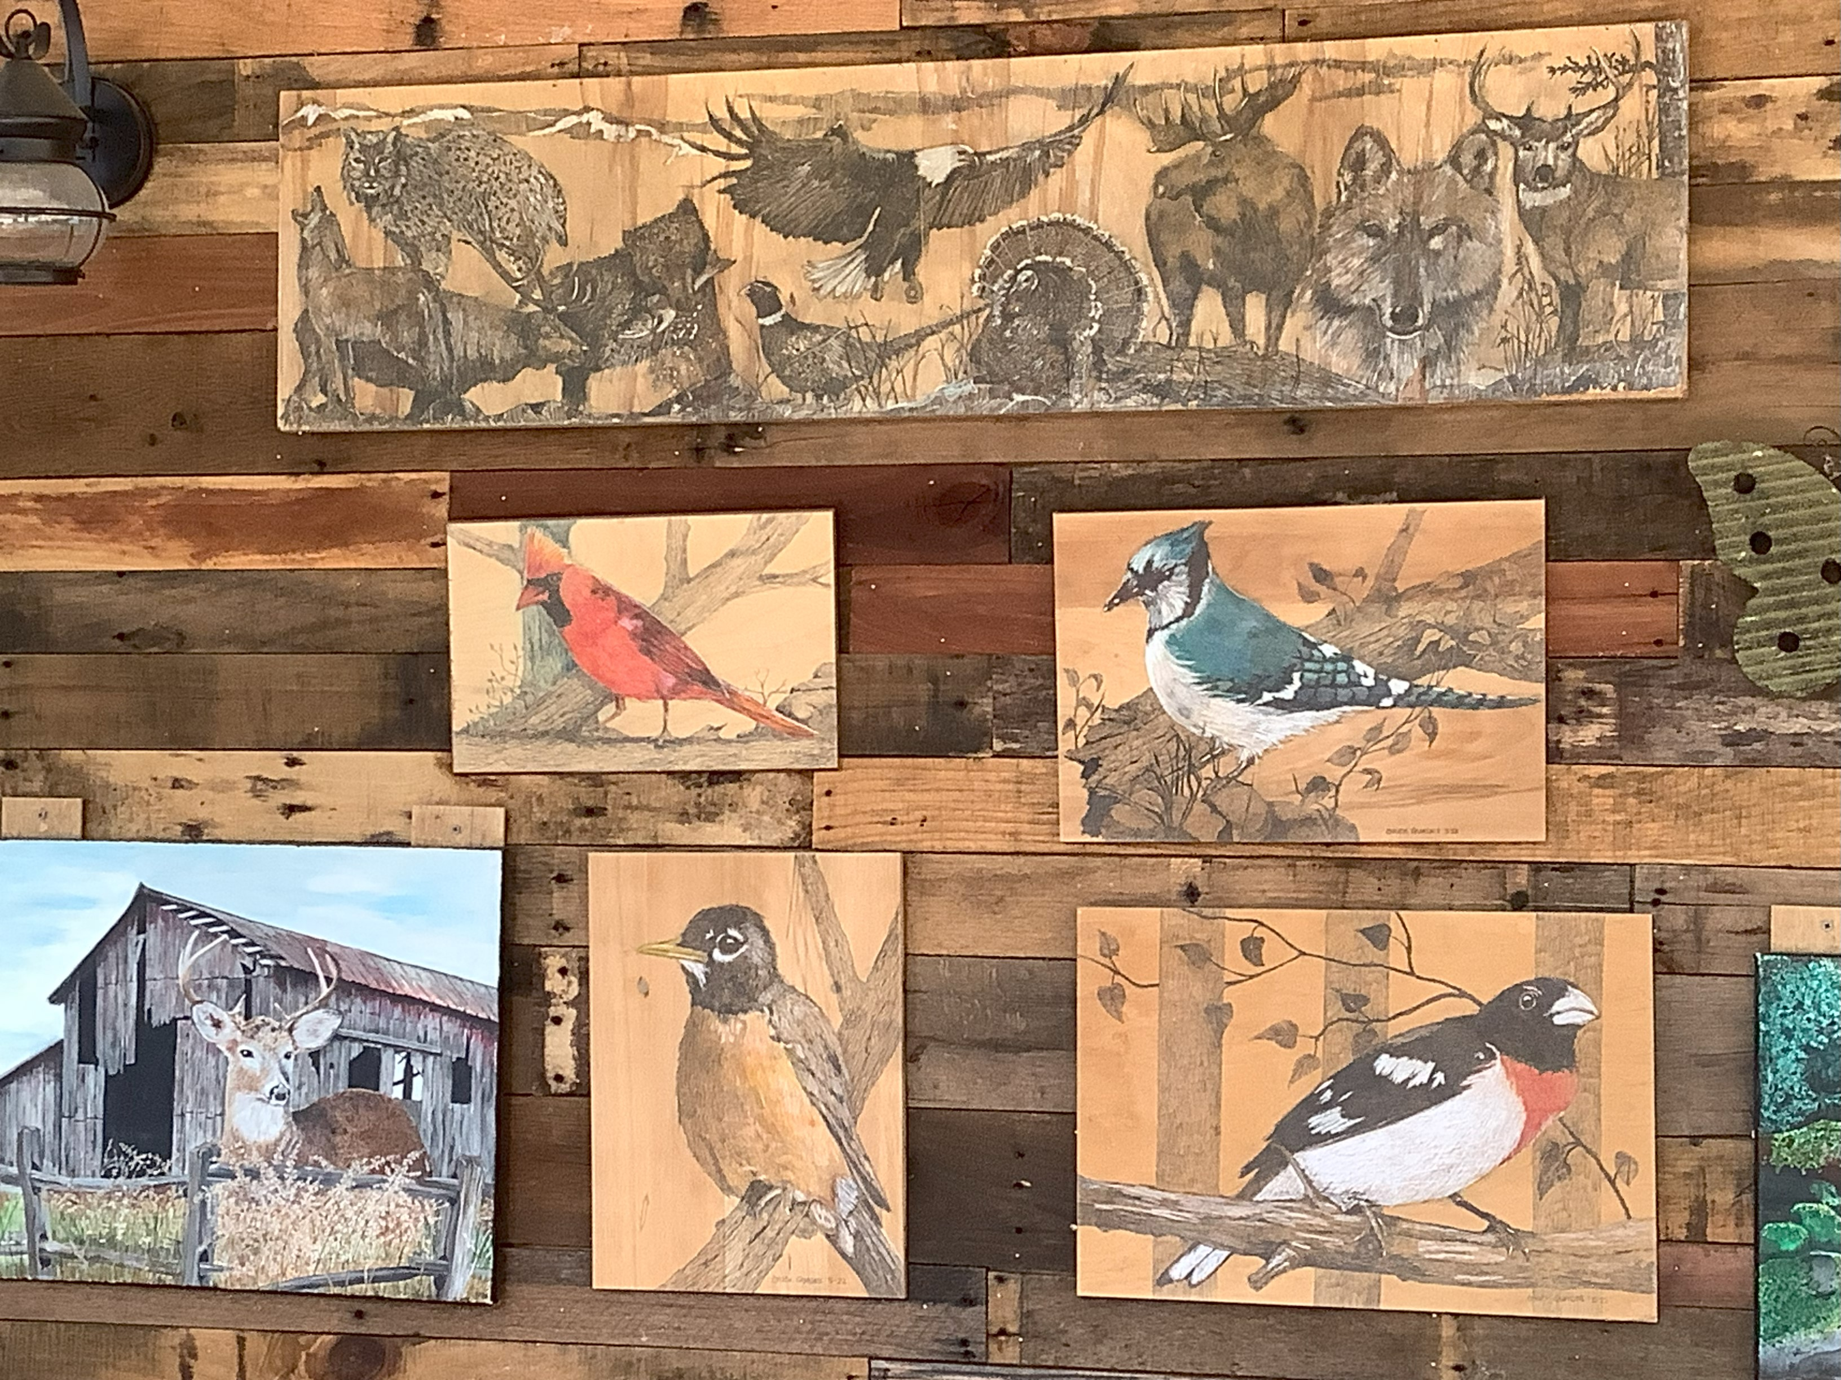
THE WOOD GUY:CHUCK QUADRI
Chuck Quadri, a local craftsman who has a background in graphic design, can do anything with wood! Many of his projects for clients and his own home, are made from free wood pallets. The project he did (below) for his own home is a combination of his wood skills and his graphic design know-how.

Slide 2
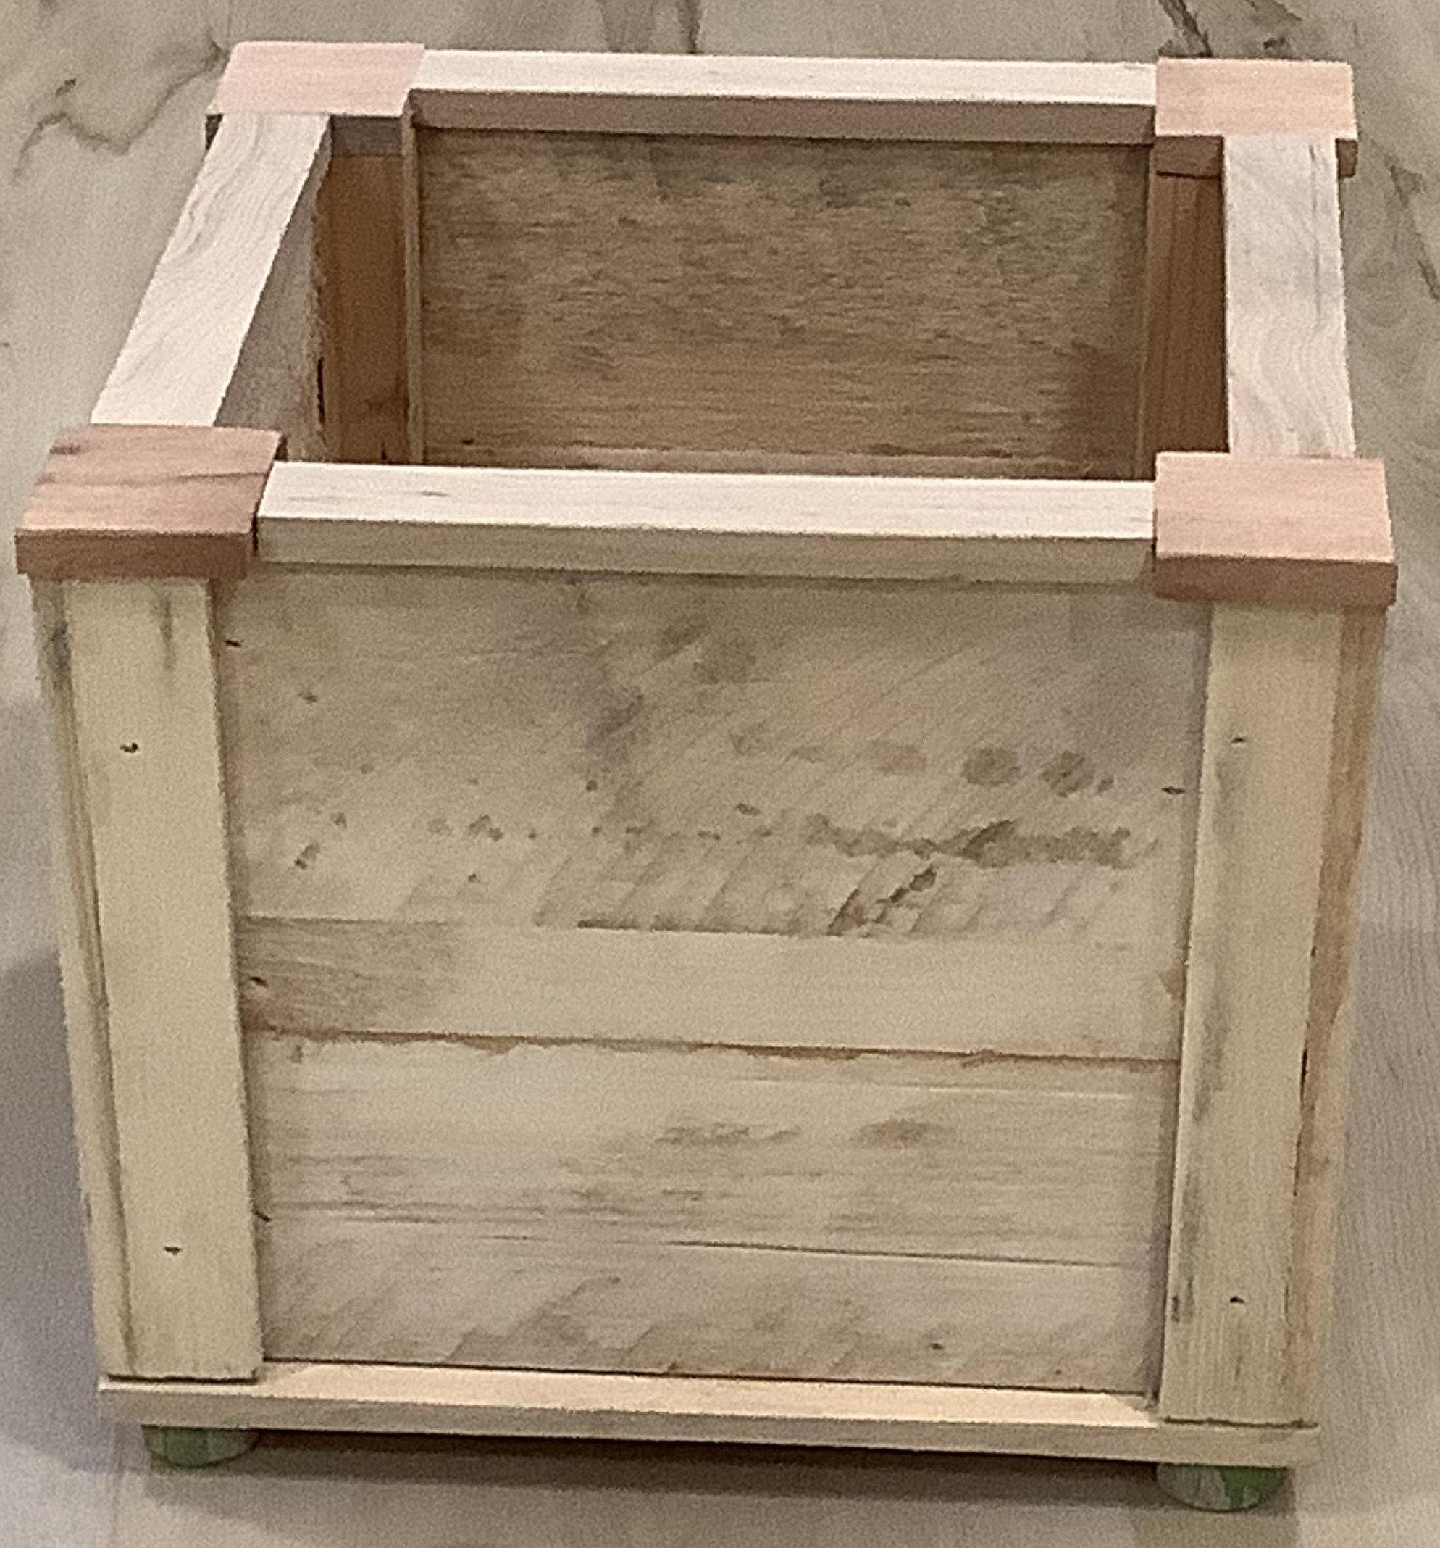
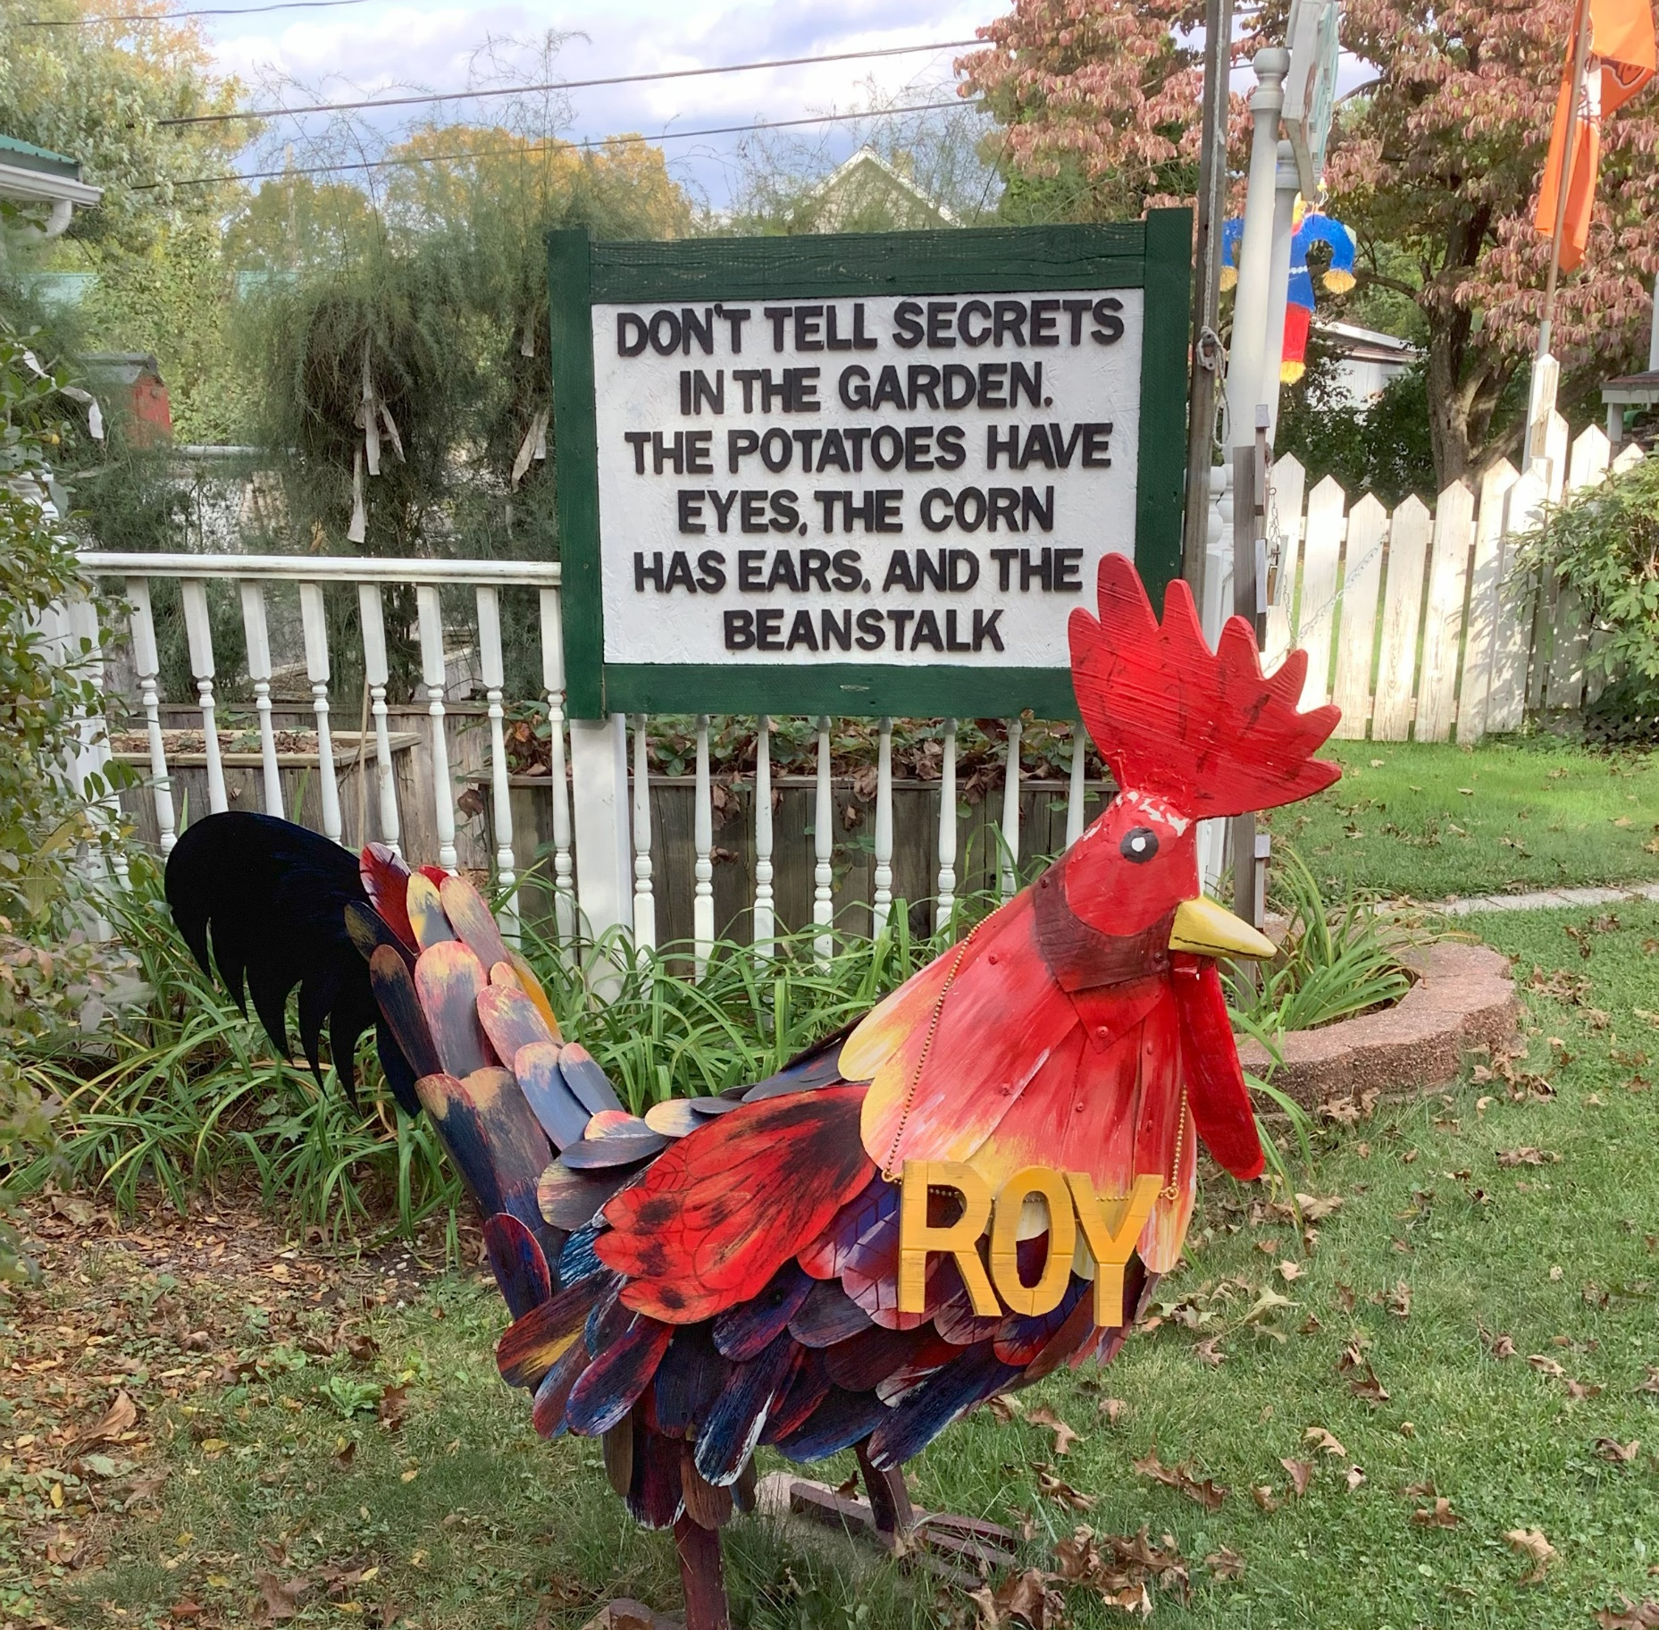
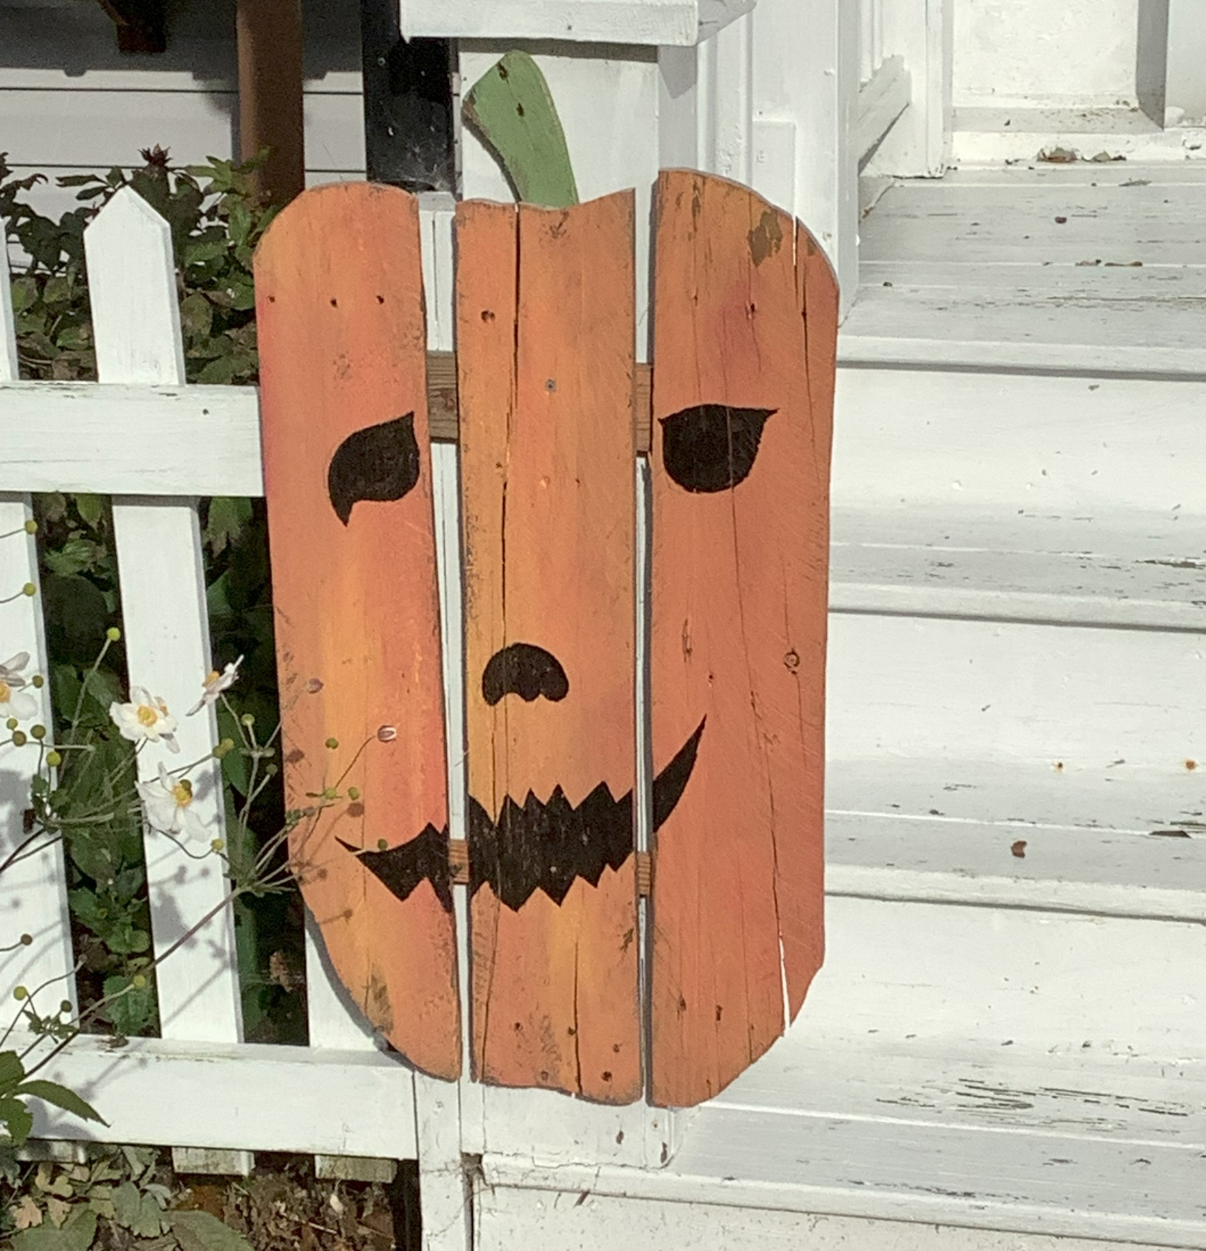
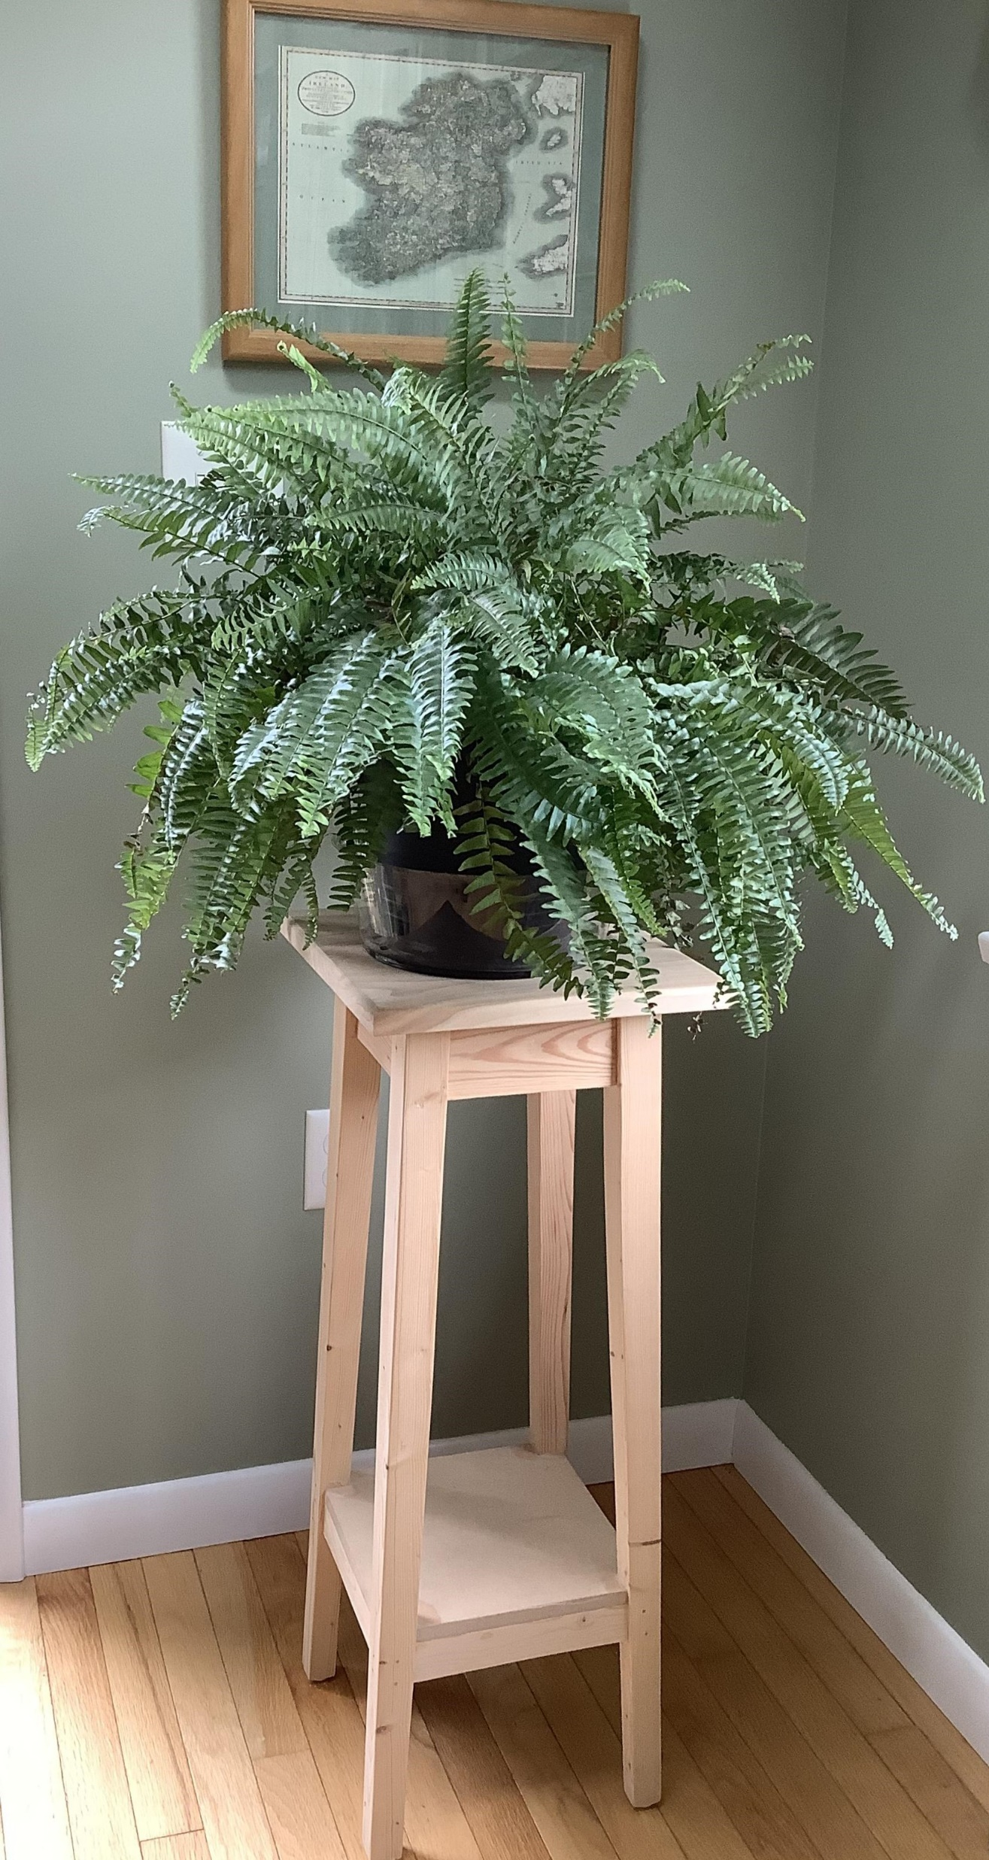
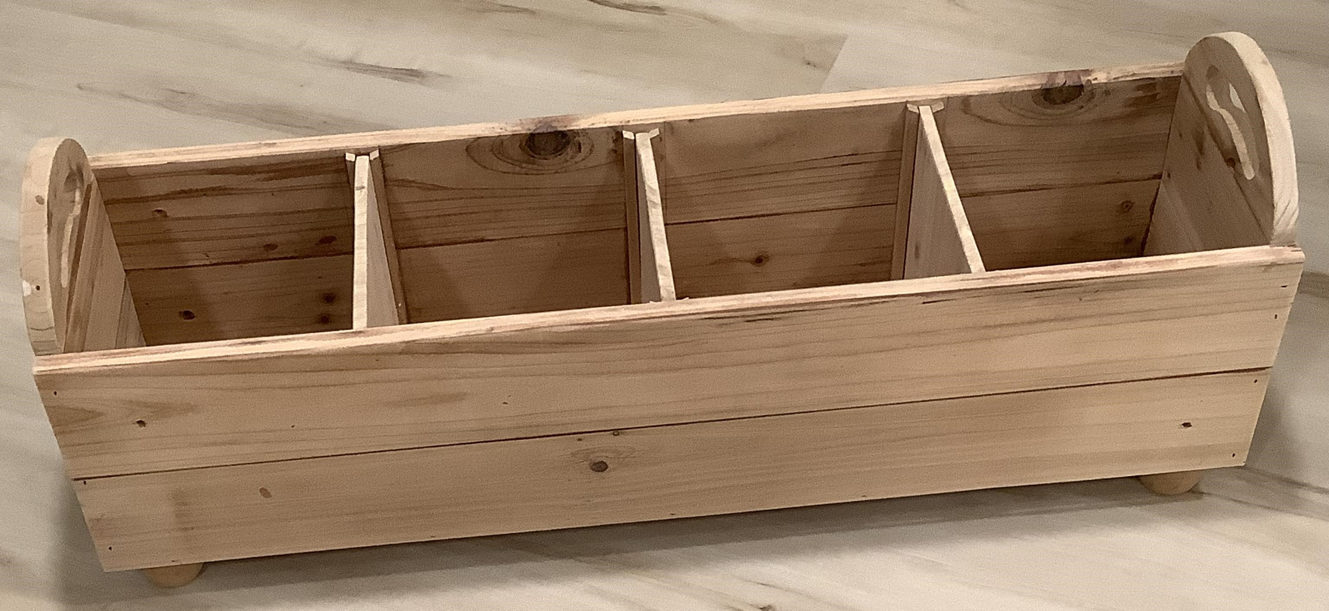
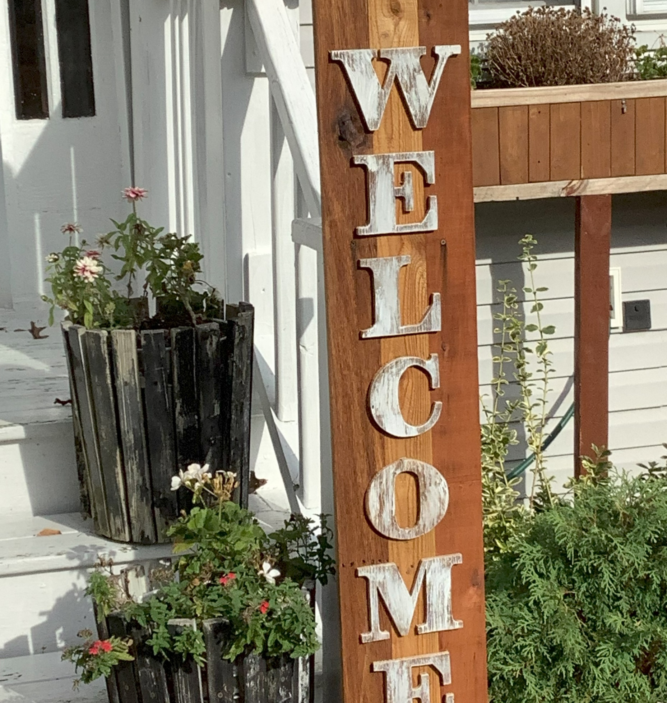
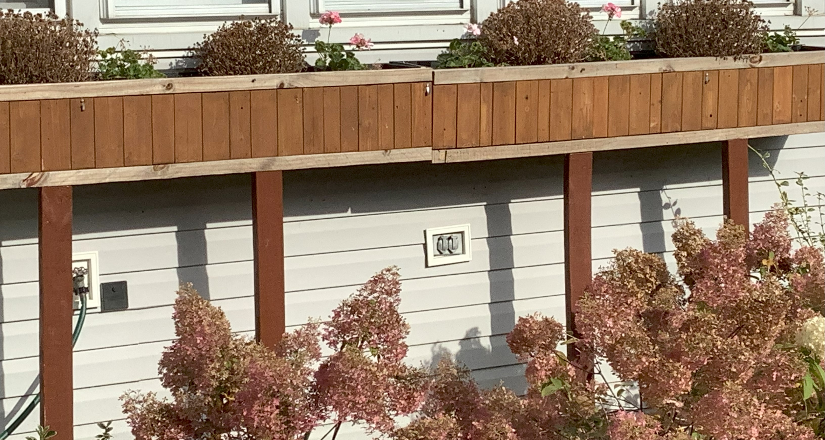
Plant stands, planter boxes, signs, statuary…
if you have an idea,
Chuck can bring it to life!

